Slide 1
266 Natural Language Processing
Week 2: Classification

Slide 2
This Week
Goals
Understand how to perform classification at the sentence level
Understand how to represent words in a neural network

Slide 3
Peeking Ahead
Week 1: Introduction
Week 2: Text Classification
Week 3: Language and Context
Week 4: Pretrained Transformers
Week 5: Text Generation Models
Week 6: Machine Translation
Week 7: Question Answering & Summarization
Week 8: Linguistic Representation
Week 9: Entities and Linking
Week 10: Embedding-based Retrieval
Week 11: Multimodality in NLP
Week 12: ML Fairness and Privacy
Week 13: NLP in the Real World

Slide 4
Announcements
Assignment 0 (Setup) - already released
Due (Sunday, 01/21)
Please come to an office hour if you are having difficulty with it
Assignment 1 (NN) released this Friday 01/19
Due Sunday, 01/28 (Tuesday 1/30 if you use late days)
Assignment 2 released next Friday 01/26
Project Proposals - Due (02/18)!
Will discuss next week
Questions?
Concerns?

Slide 5
Announcements
Paper reading sessions:
How to read a paper and A Sensitivity Analysis of (and Practitioners' Guide to) Convolutional Neural Nets for Sentence Classification
Mark: Tuesday 01/23 5:30 pm PST
oLMpics-On What Language Model Pre-training Captures
Mark: Tuesday 01/30 5:30 pm PST
Notebook Walkthroughs:
TBD
TBD
Questions?
Concerns?

Slide 6
The Plan
Structure of Class
Review of last week
Classification - Theory & Notebooks:
DANs
CNNs
Outlook: Beyond Text Classification

Slide 7
Review of Last Week’s Material
Classification

Slide 8
Networks and Matrices
H
X
H
Q
H
H
Q
Dimensions?
X
H
W
W
W
?
relu(z)
relu(z)
x
x
q
+
=
+
z
=
=
+
z
z
b
b
b
Notes:
Pink = input
H1 = blue
H2 = yellow
Output = green

Slide 9
Networks and Matrices
H
X
H
Q
H
H
Q
X
H
W
W
W
?
relu(z)
relu(z)
x
x
x
q
+
=
+
z
=
=
+
z
z
b
b
b
Notes:
Pink = input
H1 = blue
H2 = yellow
Output = green

Slide 10
NNs with Batching
H
X
H
O
H
H
O
Dimensions?
X
H
W
W
W
softmax(z)
relu(z)
relu(z)
x
x
x
+
=
+
=
+
=
b
q
b
z
z
b
z
Notes:
Pink = input (4 observations)
H1 = blue (4 hidden states but W and b are same size as they get re-used for each observation)
H2 = yellow (4 hidden states but W and b are same size as they get re-used for each observation)
Output = green (4 predictions)

Slide 11
NNs with Batching
H
X
H
O
H
H
O
X
H
W
W
W
softmax(z)
relu(z)
relu(z)
x
x
x
+
=
+
=
+
=
b
q
b
z
z
b
z
Notes:
Pink = input (4 observations)
H1 = blue (4 hidden states but W and b are same size as they get re-used for each observation)
H2 = yellow (4 hidden states but W and b are same size as they get re-used for each observation)
Output = green (4 predictions)

Slide 12
Other Neural Net Questions
What is Softmax?
What are the dimensions of the output layer if I have k classes? What about k = 2?
What is the standard classification cost function? What is the intuition here?
‘Why neural nets’ in the first place?

Slide 13
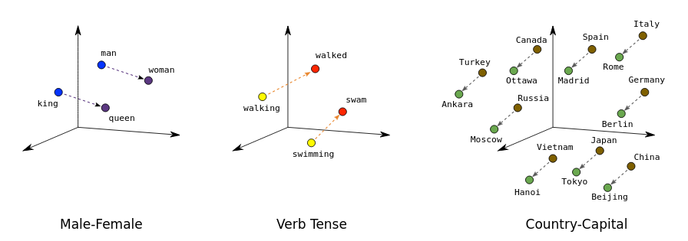
Embeddings
What do we see here? Why is it significant?
What is the Embedding Matrix?
Image Source: developers.google.com

Slide 14
Mathematically equivalent: one-hot & word vectors
Usually presented as a “lookup” in some table, but…
(Only) think of a word as a one-hot vector:
X = [0 0 1 … 0 0 …. 0 0 0] ← 10k dimension?
Then we do matrix multiplication:
“the”
E =
0 0 1 0 0 0 0
W
X
Vector for “the”
Word Embeddings!
Reasonable that similar words end up with similar vectors
Notes:
Key idea: map discrete things (words) into a continuous feature space.
Conceptually, just a big matrix multiply. But since one-hot vector is very sparse, convenient to just extract the column by indexing. So often we’ll refer to this as a “lookup”. (In fact, you can even shard embeddings across different servers, and just pull in the one you need!)

Slide 15
Intuition & Deep Averaging Networks
Classification

Slide 16
Discussion: The Basic Problem
What are some of the complexities trying to classify the sentiment of:
“The movie was NOT helpful. It did have a pernicious influence on society.”

Slide 17
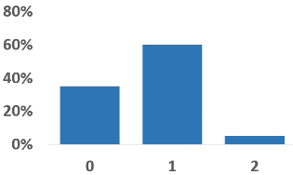
Deep Averaging Networks
Output: Probability distribution over class labels
Questions: (assume dim(embeddings) = 100)
What exactly are the benefits of embeddings here?
Dimensions:
averaging layer
hidden layer
output layer
When do we use sigmoid? When softmax? Why?
Sigmoid/Softmax
Affine
Nonlinearity
Averaging word vectors element-wise
(“bag of words”)
Affine
‘this’
‘is’
...
‘use’
Input:
“this is of great use”
Notes:
“Some movies are a wonderful, once in a lifetime, treat. The sort of amazing file that <blah blah>. THIS movie is not one of them.”

Slide 18
DAN
X₁₁
X₁₂
D
Q
X₂₁
A₁
X₂₂
D
A₂
Q
X₃₁
X₃₂
D
X₄₁
X₄₂
Word embeddings (X)
dense hidden layer (D)
output layer (Q)
averaging layer (A)
this
delightful
movie
got
laughs
W
W
softmax(z)
relu(z)
x
x
q
+
=
=
z
+
z
b
b
Notes:
Pink = input (4 observations)
H1 = blue (4 hidden states but W and b are same size as they get re-used for each observation)
H2 = yellow (4 hidden states but W and b are same size as they get re-used for each observation)
Output = green (4 predictions)

Slide 19
Let’s Build This!
Notebook

Slide 20
Convolutional Neural Networks
Classification

Slide 21

CNN Intuition
Discussion Points
What are those 4 boxes?
‘Why’ are there 4 of them?
How should their actual number be chosen?
How we choose the sizes? In fact, what are the dimensions?

Slide 22
CNN Intuition
Discussion Points
What is s?
How does s affect the feature map size?
Intuitively, how could we think about setting s?
s
Notes:
s=stride

Slide 23
Some Math: Convolutional Layer
0 | 0 | 0 | 1 | 0 | 0 | 0 | 1 | 0 | 0 | 0 | 0 | 0 | 1 | 1 | 0 | 0 | 0
0 | 0 | 0 | 0 | 1 | 1 | 1 | 1 | 1 | 0 | 0 | 0 | 0 | 0 | 1 | 1 | 0 | 0
0 | 0 | 0 | 1 | 0 | 0 | 0 | 0 | 0 | 0 | 0 | 0 | 0 | 1 | 0 | 0 | 0 | 0
Input:
Questions
What are the actual dimensions of the filter?
How would I calculate x?
What is the interpretation of x?
What is the step size s in this picture?
Is padding used? Wait… what is padding?!?
Construct filter with kernel size 5:
?
k = 5
Feature map
(output neurons):
.. | .. | x

Slide 24
Some Math: Convolutional Layer
Input values V:
0 | 0 | 0 | 1 | 0 | 0 | 0 | 1 | 0 | 0 | 0 | 0 | 0 | 1 | 1 | 0 | 0 | 0
0 | 0 | 0 | 0 | 1 | 1 | 1 | 1 | 1 | 0 | 0 | 0 | 0 | 0 | 1 | 1 | 0 | 0
0 | 0 | 0 | 1 | 0 | 0 | 0 | 0 | 0 | 0 | 0 | 0 | 0 | 1 | 0 | 0 | 0 | 0
0 | 1 | 3 | 2 | −2
2 | −2 | −1 | 3 | −2
1 | 3 | 4 | −2 | −1
Receptive field for this output neuron
Filter with “kernel size 5”:
Questions: If there was an input layer U prior to this, and V was the result of a convolutional layer C with k = 5 acting on U… - what is the width of x’s receptive field in U?
Dot product + Relu activation:
Feature map
(output neurons):
.. | .. | x=4

Slide 25
Some Math: Convolutional Layer
Input values V:
0 | 0 | 0 | 1 | 0 | 0 | 0 | 1 | 0 | 0 | 0 | 0 | 0 | 1 | 1 | 0 | 0 | 0
0 | 0 | 0 | 0 | 1 | 1 | 1 | 1 | 1 | 0 | 0 | 0 | 0 | 0 | 1 | 1 | 0 | 0
0 | 0 | 0 | 1 | 0 | 0 | 0 | 0 | 0 | 0 | 0 | 0 | 0 | 1 | 0 | 0 | 0 | 0
0 | 1 | 3 | 2 | −2
2 | −2 | −1 | 3 | −2
1 | 3 | 4 | −2 | −1
Receptive field for this output neuron
Filter with “kernel size 5”:
Questions: If there was an input layer U prior to this, and V was the result of a convolutional layer C with k = 5 acting on U… - what is the width of x’s receptive field in U? - how many filters were in C?
Dot product + Relu activation:
Feature map
(output neurons):
.. | .. | x=4

Slide 26
(Max) Pooling
Questions
What is going on here?
Why would we possibly do that?
What is the intuition for max pooling vs average pooling?
How would we - ultimately - actually do a classification?
1 | 0 | 2 | 1 | −1 | 3
0 | 1 | −2 | 0 | 2 | 1
−1 | −1 | 0 | 0 | 1 | 2
3 | 4 | 1 | 0 | −1 | 4
2 | 3 | 1 | −3 | −2 | 3
2 | 3 | 1 | -2 | 5 | -3
2

Slide 27
What Does That Have To Do With Text Classification?
Questions
How could we use this approach for text classification?

Slide 28
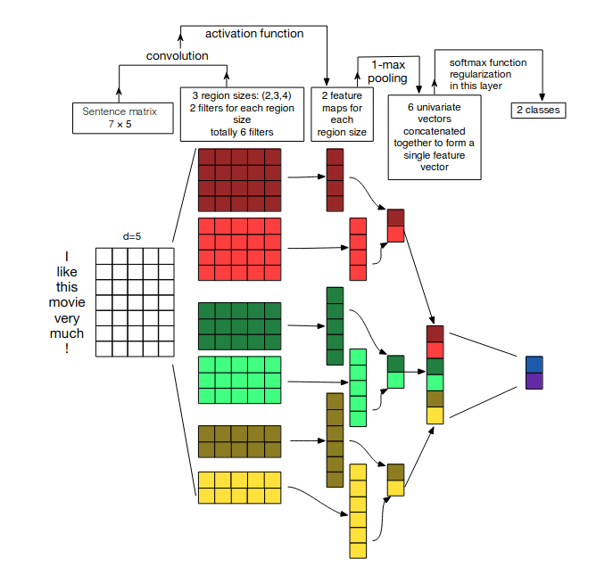
What Does That Have To Do With Text Classification?
Questions
What is the use of word vectors here?
Why are there multiple filters of the same size?
How are the feature maps being calculated? Why do they have different lengths?
Is max pooling here applied in the same way as in the image-inspired scenario?
Would we use pre-trained word vectors or train our own?
Source: Zhang, Wallace, A Sensitivity Analysis of (and Practitioners’ Guide to) Convolutional Neural Networks for Sentence Classification, https://arxiv.org/pdf/1510.03820.pdf

Slide 29
What Does That Have To Do With Text Classification?
Questions
Can we distinguish here:
“This was pretty bad. Really not good”, vs
“This was pretty good. Really not bad”
Why? Or Why Not?
What filter sizes may most matter in this example:
“This was not, despite best attempts, very good”
Source: Zhang, Wallace, A Sensitivity Analysis of (and Practitioners’ Guide to) Convolutional Neural Networks for Sentence Classification, https://arxiv.org/pdf/1510.03820.pdf

Slide 30
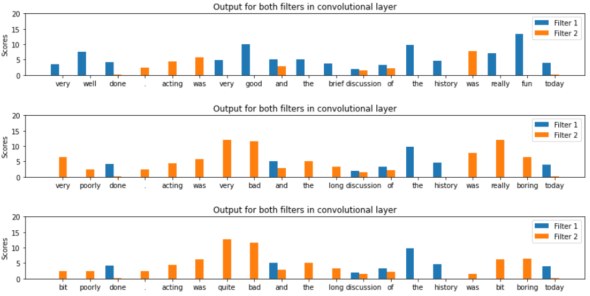
What’s Got That To Do With Text Classification?
Toy example derived from Stanford Sentiment Treebank:
converted to binary labels
2 filters only (don’t do that!)
average pooling (non-standard)
…
What was the punchline of this toy example?
Would you expect to see so clean results with 100 filters?

Slide 31
CNN
X₁₁
X₁₂
F
P₁
D
O
F
F₁
X₂₁
X₂₂
Conv size 2 filter (F₁)
P₂
D
O
Word embeddings (X)
X₃₁
X₃₂
F
W
F₂
h
X₄₁
X₄₂
=
this
delightful
movie
got
laughs
x
Max pool (P₁)
Dense hidden layer (D)
Output layer (O)
W
W
softmax(z)
relu(z)
x
x
h
q
x
W
Max pool (P₂)
+
=
+
=
Conv size 3 filter (F₂)
=
z
z
b
b

Slide 32
CNN Example
Conv size 2 filter (F₁)
Word embeddings (X)
Best match for filter F₁ is the last bigram, “got laughs”
W
h
1
2
3
=
max pool (P₁)
-1
9
this
delightful
movie
got
laughs
1
0
x
-8
4
2
-2
11
-1
3
11
0
1
6
Best match for filter F₂ is the first trigram, “this delightful movie”
2
-3
h
x
W
max pool (P₂)
Conv size 3 filter (F₂)
=
6
2
0
-1
1
-1
-6
0
1

Slide 33
Let’s Build This!
Notebook

Slide 34
Paper Peeks/Recent Advances/Challenges
Classification

Slide 35
Some Papers
The original Deep Average Network paper:
Deep Unordered Composition Rivals Syntactic Methods
for Text Classification
CNNs can still play a role in NLP:
Are Pre-trained Convolutions Better than Pre-trained Transformers?

Slide 36
Extras
Classification

Slide 37
Outlook: Beyond Text Classification
Introduction

Slide 38
How do we think about NLP?
NLP can be characterized as:
A set of tasks involving language
Tasks are cast as a particular type of problem structure
A set of data that incorporates the linguistic features and relations that characterize the task and problem
A model architecture is selected to learn to make inferences about the task
The parameters of the model are trained to best fit the training data
This class will teach you to address common NLP tasks by architecting, coding, and training appropriate model architectures (usually neural networks) using appropriate data

Slide 39
Some NLP Tasks
Question Answering
Machine translation
Summarization
Natural Language Inference (NLI)
Sentiment Analysis
Semantic Role Labeling
Relation Extraction
Goal Directed Dialog
Semantic Parsing
Commonsense Reasoning
Text Classification
Language Modeling
Entity Recognition
Word Sense Disambiguation
Part of speech tagging
Phrase extraction
Fact extraction
… and more …

Slide 40
Brainstorming: “What kind of problem is this?”
Sentiment Analysis
Statement: “I have seen better movies”
Task: What is the sentiment?
What kind of problem is this? How could this be approached?
→ Classification (..today)

Slide 41
Brainstorming: “What kind of problem is this?”
Language Modeling
Context: “I will not have time later this …”
Task: What is ‘…’ ? [i.e., next-word prediction]
What kind of problem is this? How could this be approached?

Slide 42
Brainstorming: “What kind of problem is this?”
Translation
Context: “The grass is green but the sky is blue.”
Task: Translate to German: (‘Das Grass ist gruen, aber der Himmel ist blau.’)
What kind of problem is this? How could this be approached?

Slide 43
Brainstorming: “What kind of problem is this?”
Question Answering
Statement (from Joe Biden’s Wikipedia page): “Born and raised in Scranton, Pennsylvania, and later in New Castle County, Delaware, Biden studied at the University of Delaware before earning his law degree from Syracuse University in 1968. He was elected to the New Castle County Council in 1970 and became the sixth-youngest senator ever when he was elected to the U.S. Senate from Delaware in 1972, at age 29…. ”
Question: “Where did Joe Biden get his law degree?”
What kind of problem is this? How could this be approached?

Slide 44
Some Network and Model Architectures
NLP uses a wide variety of network architectures to perform tasks:
Multi-layered Perceptron (MLP)
Deep Averaging Network (DAN)
Convolutional Neural Net (CNN)
Recurrent Neural Nets (RNN, GRU, LSTM)
Transformers (Self-attention)
Sequence to Sequence (Encoder Decoder)
Generative Adversarial Network (GAN)
Dual Encoders
….

Slide 45
Tasks -> problem structures -> Architectures*
Task | Standard Problem Structure | Architectures
Question Answering | Span Detection, Answer Retrieval | Sequence labeling, Transformers
Machine translation | Sequence to sequence | Transformers, Encoder - decoder
Abstractive Summarization | Sequence to sequence | Transformers, Encoder - decoder
Natural Language Inference (NLI) | Text Pair Classification | Various
Sentiment | Classification | Transformers, CNN
Semantic Role Labeling (SRL) | Sequence Labeling | Transformers, LSTM
Relation Extraction | Classification | various
Goal Directed Dialog | Sequence to sequence | Encoder - decoder
*No claim of completeness is made…

Slide 46
A Canonical Approach
Probability distribution of predictions
Understand problem structure and define exact task
Acquire (or create) data
Decide on the model
Identify proper text representation
Words as strings or “one hot vectors” or dense low dimensional vectors
Think about how to best deal with sequential nature of text
Define architecture and layers etc.
Ensure model output models the task (usually some probability distribution)
Crank the ML machine...
positive neutral negative
Model
(usually some NN architecture)
“I really enjoyed this movie!”

Slide 47
Resources for NLP Tasks (and data)
NLP Progress - list of NLP tasks and state of the art (SOTA) metrics
NLP Decathlon - ten standard tasks described and recast as Q & A
Glue - a set of standard tasks with a common scoring framework
Super Glue - additional tasks that are “harder”

Slide 48
Summary and Outlook

Slide 49
How to train? Unsupervised training
Training word representations w/o a supervised task
Key idea Word representations should predict their context and vice versa. Mechanisms
Skip-gram: Train representations to predict context around a word CBOW: Train representation to predict word from surrounding context
Notes:
Distributional hypothesis: let’s try to learn meaning of words (as vector representation), by predicting the words around them.

Slide 50
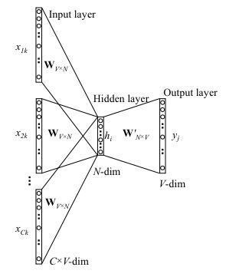
CBOW - Continuous Bag-of-Words
Predicts a word given its context - P(word|context)
1.“Embeddings empower [mask] accurate classification”
2.“Embeddings empower less accurate classification”
3.“Embeddings empower spaceship accurate classification”
Mechanism Predict middle word using avg. context representation:
Maximizes P(word | avg(context))
P(more| avg(embeddings, empower, accurate, classification))
Learn W and W’ matrices - W is embedding matrix
Word2vec parameter learning explained
Notes:
RAW = “It’s raining cats and dogs”
X = [“it’s”, “raining”, “and”, ”dogs”]
y = “cats”
(really, y = one-hot encoding for the word “cats”)

Slide 51
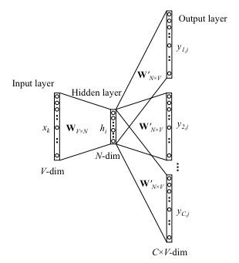
Skip-Gram Model
Predicts context around a word - P(context|word)
“Embeddings empower more accurate classification”
Mechanism
Randomly samples R words from context window
Positive word pairs (more, embeddings)(more, empower) AND negative word pairs
Maximizes P(context_{i∈R} | word_{t})
Learn W and W’ matrices - W is embedding matrix
Word2vec parameter learning explained
Notes:
[0 1 0 0 0 0 0 0 … ]
[0 0 1 0 0 0 0 0 … ]
y’ = h*W’ = [0 ? ? 0 0 0 0 0 ….]
[0 0 1]
[0 1 0]
[1 0 0]

Slide 52
Illustrated word2vec
https://jalammar.github.io/illustrated-word2vec/

Slide 53
Brainstorming: Entropy Estimate
Next-Word Prediction:
Training data:
“This class is great when we talk about modern NN architectures”
Prediction Task:
“This class is [token]”
Token Options:
great, boring, difficult, easy
Predicted token? Best guess for p? Entropy?

Slide 54
Brainstorming: Entropy Estimate
Next-Word Prediction:
Training data:
“This class is great when we talk about modern NN architectures”
“This class is difficult when we talk about complex NN architectures”
Prediction Task:
“This class is [token]”
Token Options:
great, boring, difficult, easy
Predicted token? Best guess for p? Entropy?

Slide 55
Brainstorming: Entropy Estimate
Next-Word Prediction:
Training data:
“This class is great when we talk about modern NN architectures”
“This class is difficult when we talk about complex NN architectures”
“This class is difficult when we talk about complex NLP questions”
Prediction Task:
“This class is [token]”
Token Options:
great, boring, difficult, easy
Best guess for p? Entropy?

Slide 56
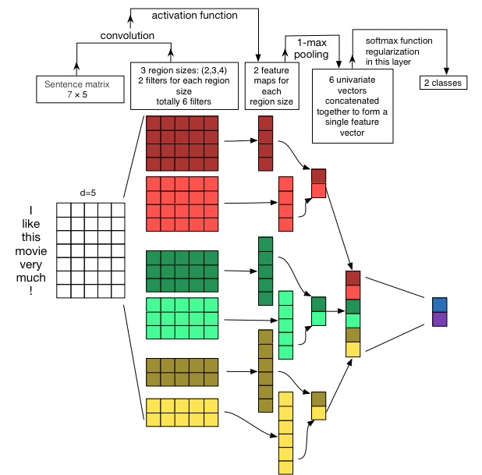
Source: Zhang, Wallace, A Sensitivity Analysis of (and Practitioners’ Guide to) Convolutional Neural Networks for Sentence Classification, https://arxiv.org/pdf/1510.03820.pdf

Slide 57
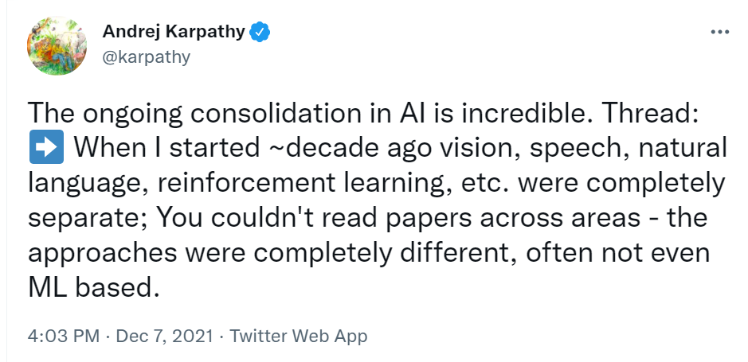
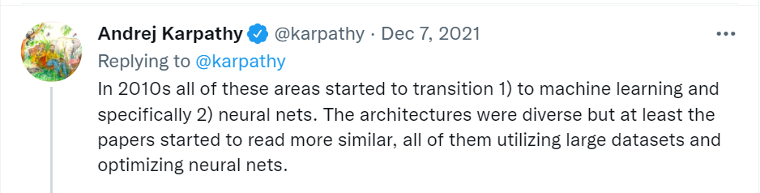
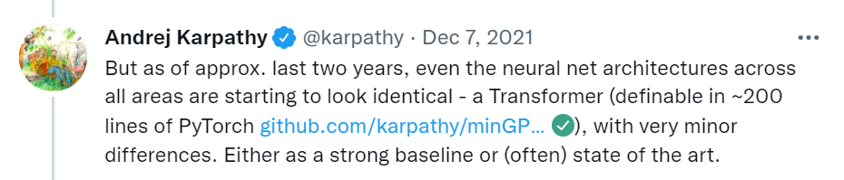
Nice Summary of “Why This Class is So Exciting (To Me)”
Andrej Karpathy (Director of AI at Tesla) on Twitter in December ‘21:

